Slide 1



BUY & WIN CONTEST
Contest mechanic - Hybrid
Join with one receipt. Collect Mata for more chances.
BUY RM25 OF SAJI
THE GOAL
Make joining easy so more shoppers enter, then reward every repeat purchase from 30 January to 11 April.
ANSWER QUESTION,
REGISTER & UPLOAD
ENTRY
Option 2
ENTRY
COMMITMENT
1 ENTRY
Easy to join
A reason to come back
= 1 ENTRY
= MORE ENTRIES
KEEP BUYING, COLLECT MATA
One RM25 receipt and one answer put you in this week's draw and the grand prize draw.
Buy SAJI every week to collect more Mata and gain more chances to win.
COMMITMENT
Option 1
MORE ENTRIES
Notes:
- SAJI liked both mechanics, so we joined them. Option 2 (buy, answer, upload) is the entry: anyone can join with one receipt. Option 1 (collect Mata) is the commitment: every extra purchase earns more chances.
- A shopper who only wants one chance stops at the first entry. A contest fan keeps collecting on the same account.
- You answer one question once, when you join, and it stays the same for all 10 weeks. Later receipts only need a scan and an upload. Confirm with counsel that a fixed question meets the permit's skill requirement.

Slide 2





BUY & WIN CONTEST
Contest mechanic - Entries
You get one entry for every 25 Mata.
Four ways to earn Mata.
The one rule
START HERE
RM25 OF SAJI
=
25 MATA
SAJI
Receipt
Product of
the Week
Bonus
QR Code
Buy Each Week
or Refer a Friend
RM1 = 1 Mata
2x or 3x Mata
25 to 50 Mata
25 Mata
=
1 ENTRY
Find bonus QR codes on special SAJI packs and at SAJI events, in every state.
WEEKLY DRAW
GRAND PRIZE DRAW
Your first receipt needs at least RM25 of SAJI.
Only this week's entries count, so buy every week to stay in.
Every entry since 30 January counts for the top 3 prizes.
Notes:
- One number to remember: 25 Mata is one entry. RM1 of SAJI is 1 Mata, so RM25 of SAJI is one entry.
- No double count: the first RM25 receipt is the first 25 Mata, which is the first entry.
- The weekly draw uses that week's entries, so a shopper has a reason to buy every week. The grand prize draw (the top 3 prizes) uses every entry since 30 January, so someone who joined in week 1 is still in it on 11 April. Prize amounts stay on the prize structure slides.
- Bonus QR codes are on packs and shelves nationwide, and event codes pay the same, so shoppers outside KL are not behind.
- We count each receipt once and cap Mata per receipt, so a bulk buyer cannot take over the draw.

Slide 3
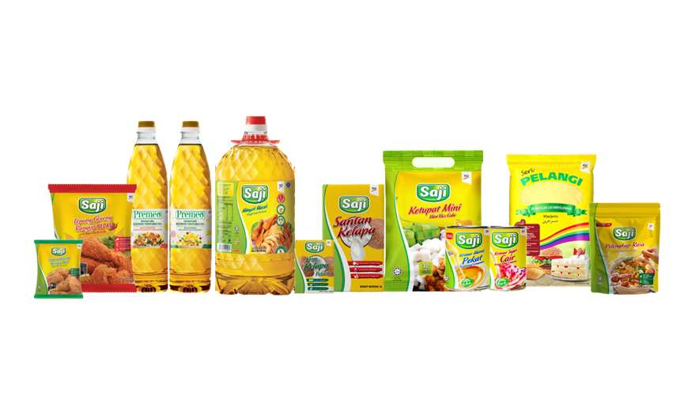
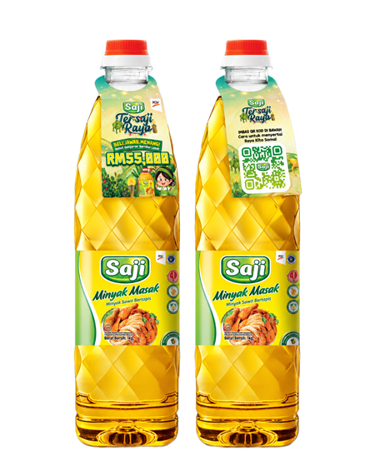
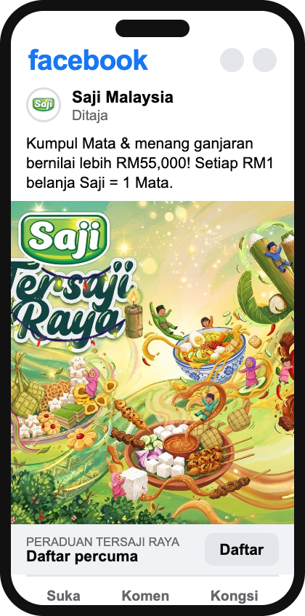
BUY & WIN CONTEST
Contest mechanic - How to join
Register once. After that, you only scan and upload.
1
2
3
4
5
BUY SAJI
SCAN THE QR
ANSWER,
REGISTER
& UPLOAD
GET 1 ENTRY
KEEP UPLOADING
Buy at least RM25 of SAJI at any shop. Keep your receipt.
Scan the contest QR on the pack or shelf, or tap our ad.
Answer one question, add your details and upload your receipt.
You are in this week's draw and the grand prize draw.
Upload every new SAJI receipt to collect Mata and gain more chances to win.
CONTEST PAGE
after each upload
MY MATA
1 entry so far
40
Mata
Buy RM10 more of SAJI and upload the receipt for your next entry.
Notes:
- One journey for everyone. The QR on the pack works at home after shopping, the QR on the shelf works in store, and the ad link works from TikTok or Facebook. All three open the same contest page.
- Steps 1 to 4 happen once. Step 5 is the habit: every new receipt is a scan and an upload, which adds Mata and more chances to win.
- After each upload, the contest page shows the shopper's Mata balance, their entries so far and how much more SAJI gets the next entry. We use that gap to bring them back to the shelf.
- The balance lives on the contest page we already build, so it needs no WhatsApp setup. A shopper can also check it any time by logging in with their phone number.
- A promoter at the sampling booth can help anyone who gets stuck, and the flyer carries the same four steps.

